Slide 1
W4111 – Introduction to Databases: Section 002, Spring 2021 Lecture 11: Normalization, Transactions
© Donald F. Ferguson, 2021

Slide 2
W4111 – Introduction to Databases: Section 002, Spring 2021 Lecture 11: Normalization, Transactions
We will start in a couple of minutes.
© Donald F. Ferguson, 2021

Slide 3

Contents

Slide 4
Contents

Slide 5
Normalization

Slide 6
Chapter 7: Normalization

Slide 7
Outline
Features of Good Relational Design
Functional Dependencies
Decomposition Using Functional Dependencies
Normal Forms
Functional Dependency Theory
Algorithms for Decomposition using Functional Dependencies
Decomposition Using Multivalued Dependencies
More Normal Form
Atomic Domains and First Normal Form
Database-Design Process
Modeling Temporal Data

Slide 8
Overview of Normalization

Slide 9
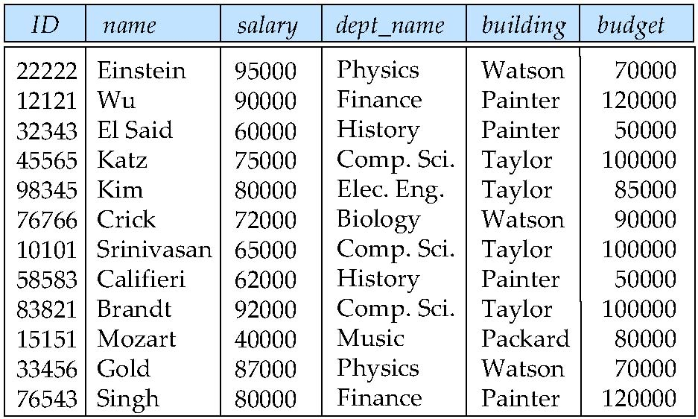
Features of Good Relational Designs
Hypothetically, assume our schema originally had one relation that provided information about faculty and departments.
Suppose we combine instructor and department into in_dep, which represents the natural join on the relations instructor and department
There is repetition of information
Need to use null values (if we add a new department with no instructors)
X → Y
X = (dept_name)
Y = (building, budget)
Pix Physics
Pix Physics
Piy (Watson, 70000)

Slide 10
Decomposition
The only way to avoid the repetition-of-information problem in the in_dep schema is to decompose it into two schemas – instructor and department schemas.
Not all decompositions are good. Suppose we decompose
employee(ID, name, street, city, salary)
into
employee1 (ID, name)
employee2 (name, street, city, salary)
The problem arises when we have two employees with the same name
The next slide shows how we lose information -- we cannot reconstruct the original employee relation -- and so, this is a lossy decomposition.

Slide 11
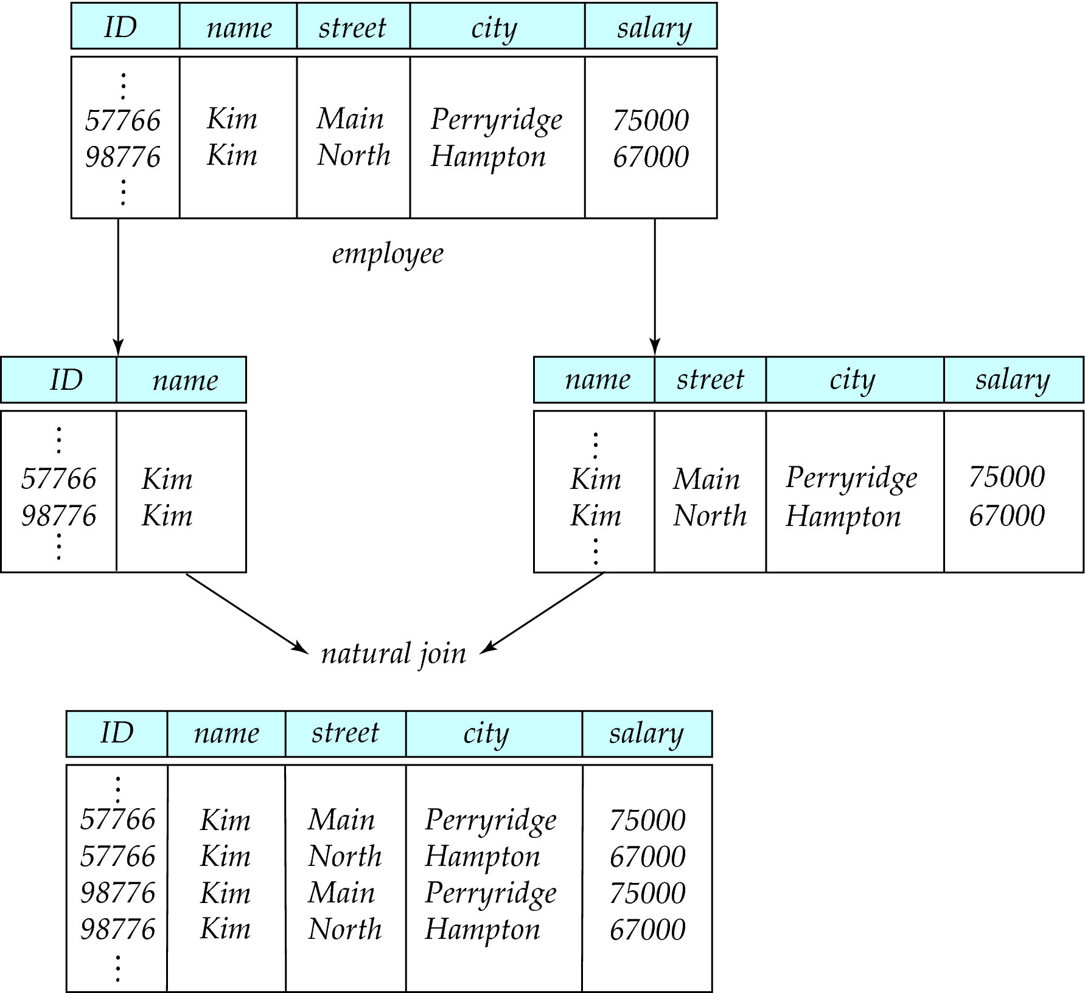
Lossy Decomposition

Slide 12
The Evils of Redundancy
Redundancy is at the root of several problems associated with relational schemas:
redundant storage, insert/delete/update anomalies
Integrity constraints, in particular functional dependencies, can be used to identify schemas with such problems and to suggest refinements.
Main refinement technique: decomposition (replacing ABCD with, say, AB and BCD, or ACD and ABD).
Decomposition should be used judiciously:
Is there reason to decompose a relation?
What problems (if any) does the decomposition cause?
Notes:
14

Slide 13
Example (Contd.)
Wages
Hourly_Emps2
Problems due to R W :
Update anomaly: Can we change W in just the 1st tuple of SNLRWH?
Insertion anomaly: What if we want to insert an employee and don’t know the hourly wage for his rating?
Deletion anomaly: If we delete all employees with rating 5, we lose the information about the wage for rating 5!
Will 2 smaller tables be better?
Notes:
17

Slide 14
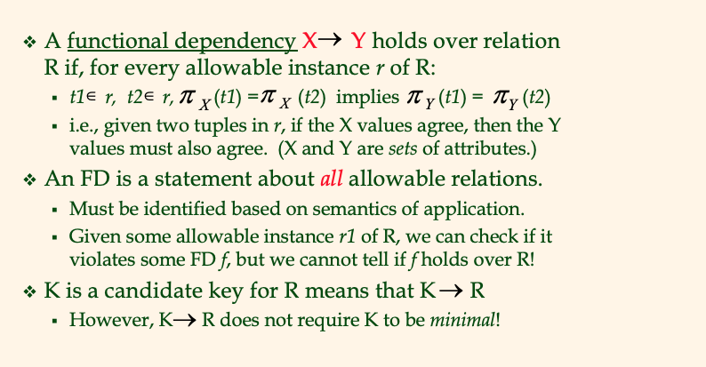
Functional Dependencies (FDs)
Notes:
15

Slide 15
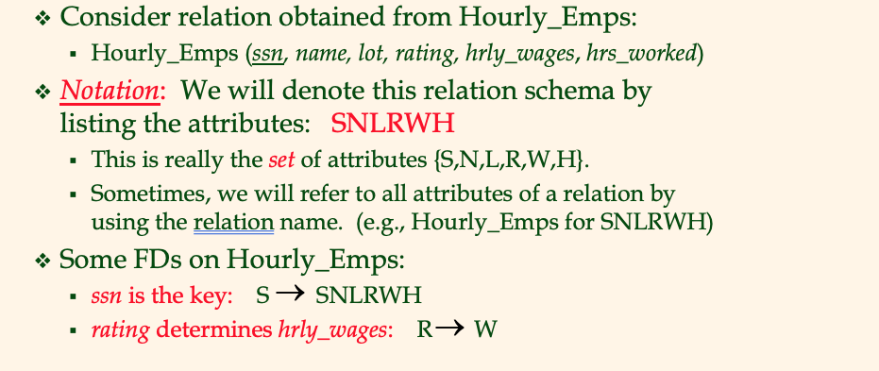
Example: Constraints on Entity Set
Notes:
16

Slide 16
F⁺
(uni, email, last_name, first_name) uni and email are candidate (not NULL, unique)
Uni → email
Email → (last_name, first_name)
➔ Uni → (last_name, first_name)
Person:(uni, email, last_name, first_name), ContactInfo: (email, phone_number, dorm_name)
Uni → email
Email → phone_number, dorm_name
Uni → phone_number, dorm_name

Slide 17
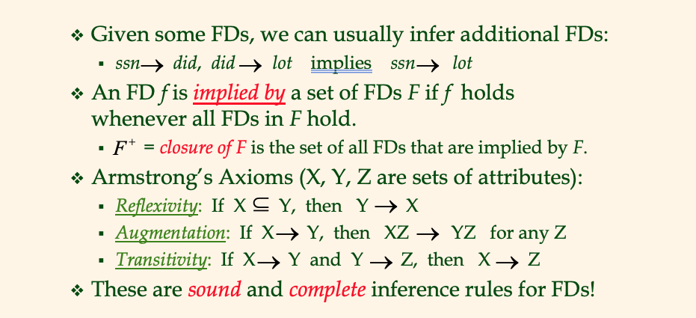
Reasoning About FDs
Notes:
19

Slide 18
Lossless Decomposition
Let R be a relation schema and let R₁ and R₂ form a decomposition of R.
That is R = R₁ U R₂
Note: This notation is confusing. This is a statement about the schema, not about the data in relations.
We say that the decomposition is a lossless decomposition if there is no loss of information by replacing R with the two relation schemas R₁ U R₂
Formally,
∏ _{R1} (r) ∏ _{R2} (r) = r
And, conversely a decomposition is lossy if
r ⊂ ∏ _{R1} (r) ∏ _{R2} (r) = r

Slide 19
Normalization Theory
Decide whether a particular relation R is in “good” form.
In the case that a relation R is not in “good” form, decompose it into set of relations {R₁, R₂, ..., R_{n}} such that
Each relation is in good form
The decomposition is a lossless decomposition
Our theory is based on:
Functional dependencies
Multivalued dependencies

Slide 20
Functional Dependencies
There are usually a variety of constraints (rules) on the data in the real world.
For example, some of the constraints that are expected to hold in a university database are:
Students and instructors are uniquely identified by their ID.
Each student and instructor has only one name.
Each instructor and student is (primarily) associated with only one department.
Each department has only one value for its budget, and only one associated building.

Slide 21
Functional Dependencies (Cont.)
An instance of a relation that satisfies all such real-world constraints is called a legal instance of the relation;
A legal instance of a database is one where all the relation instances are legal instances
Constraints on the set of legal relations.
Require that the value for a certain set of attributes determines uniquely the value for another set of attributes.
A functional dependency is a generalization of the notion of a key.

Slide 22
Functional Dependencies Definition
Let R be a relation schema
α ⊆ R and β ⊆ R
The functional dependency
α → β
holds on R if and only if for any legal relations r(R), whenever any two tuples t₁ and t₂ of r agree on the attributes α, they also agree on the attributes β. That is,
t₁[α] = t₂ [α] ⇒ t₁[β ] = t₂ [β ]
Example: Consider r(A,B ) with the following instance of r.
On this instance, B → A hold; A → B does NOT hold,
4
1 5
3 7

Slide 23
Closure of a Set of Functional Dependencies
Given a set F set of functional dependencies, there are certain other functional dependencies that are logically implied by F.
If A → B and B → C, then we can infer that A → C
etc.
The set of all functional dependencies logically implied by F is the closure of F.
We denote the closure of F by F⁺.

Slide 24
Keys and Functional Dependencies
K is a superkey for relation schema R if and only if K → R
K is a candidate key for R if and only if
K → R, and
for no α ⊂ K, α → R
Functional dependencies allow us to express constraints that cannot be expressed using superkeys. Consider the schema:
in_dep (ID, name, salary, dept_name, building, budget ).
We expect these functional dependencies to hold:
dept_name→ building
ID → building
but would not expect the following to hold:
dept_name → salary
DFF Note:
In the current data: ID → dept_name → building
But
In the schema, dept_name may be NULL..

Slide 25
Use of Functional Dependencies
We use functional dependencies to:
To test relations to see if they are legal under a given set of functional dependencies.
If a relation r is legal under a set F of functional dependencies, we say that r satisfies F.
To specify constraints on the set of legal relations
We say that F holds on R if all legal relations on R satisfy the set of functional dependencies F.
Note: A specific instance of a relation schema may satisfy a functional dependency even if the functional dependency does not hold on all legal instances.
For example, a specific instance of instructor may, by chance, satisfy name → ID.

Slide 26
Normal Forms

Slide 27
Boyce-Codd Normal Form
A relation schema R is in BCNF with respect to a set F of functional dependencies if for all functional dependencies in F⁺ of the form
α → β
where α ⊆ R and β ⊆ R, at least one of the following holds:
α → β is trivial (i.e., β ⊆ α)
α is a superkey for R
DFF Note:
The theoretical treatment is no conveying the practical intent.
If α is α superkey, I can set a primary key/unique constraint on α.
Consider tables with address info in the rows.

Slide 28
Decomposing a Schema into BCNF
Let R be a schema R that is not in BCNF. Let α →β be the FD that causes a violation of BCNF.
We decompose R into:
(α U β )
( R - ( β - α ) )
In our example of in_dep,
α = dept_name
β = building, budget
and in_dep is replaced by
(α U β ) = ( dept_name, building, budget )
( R - ( β - α ) ) = ( ID, name, dept_name, salary )
Note:
This is an example only.
Zip code does not imply city or state in real world.
DFF Note – again this is baffling
R = (id, name_last, name_first, street, city, state, zipcode)
α → β means zipcode → (city, state)
(α U β ) = (zipcode, city, state), which we call Address
R - ( β - α ) ). = R - β + α = (id, name_last, name_first, zipcode), which we call Person
Setting primary key ID in Address and zipcode on Address preserves the dependency and is lossless.

Slide 29
BCNF and Dependency Preservation
It is not always possible to achieve both BCNF and dependency preservation
Consider a schema:
dept_advisor(s_ID, i_ID, department_name)
With function dependencies:
i_ID → dept_name
s_ID, dept_name → i_ID
dept_advisor is not in BCNF
i_ID is not a superkey.
Any decomposition of dept_advisor will not include all the attributes in
s_ID, dept_name → i_ID
Thus, the composition is NOT be dependency preserving

Slide 30
Third Normal Form
A relation schema R is in third normal form (3NF) if for all:
α → β in F⁺
at least one of the following holds:
α → β is trivial (i.e., β ∈ α)
α is a superkey for R
Each attribute A in β – α is contained in a candidate key for R.
(NOTE: each attribute may be in a different candidate key)
If a relation is in BCNF it is in 3NF (since in BCNF one of the first two conditions above must hold).
Third condition is a minimal relaxation of BCNF to ensure dependency preservation (will see why later).

Slide 31
3NF Example
Consider a schema:
dept_advisor(s_ID, i_ID, dept_name)
With function dependencies:
i_ID → dept_name
s_ID, dept_name → i_ID
Two candidate keys = {s_ID, dept_name}, {s_ID, i_ID }
We have seen before that dept_advisor is not in BCNF
R, however, is in 3NF
s_ID, dept_name is a superkey
i_ID → dept_name and i_ID is NOT a superkey, but:
{ dept_name} – {i_ID } = {dept_name } and
dept_name is contained in a candidate key

Slide 32
Comparison of BCNF and 3NF
Advantages to 3NF over BCNF. It is always possible to obtain a 3NF design without sacrificing losslessness or dependency preservation.
Disadvantages to 3NF.
We may have to use null values to represent some of the possible meaningful relationships among data items.
There is the problem of repetition of information.

Slide 33
Goals of Normalization
Let R be a relation scheme with a set F of functional dependencies.
Decide whether a relation scheme R is in “good” form.
In the case that a relation scheme R is not in “good” form, need to decompose it into a set of relation scheme {R₁, R₂, ..., R_{n}} such that:
Each relation scheme is in good form
The decomposition is a lossless decomposition
Preferably, the decomposition should be dependency preserving.

Slide 34
Universal – Ferguson’s Law of Useful Normalization and Konstraints (U—FLUNK)

Slide 35
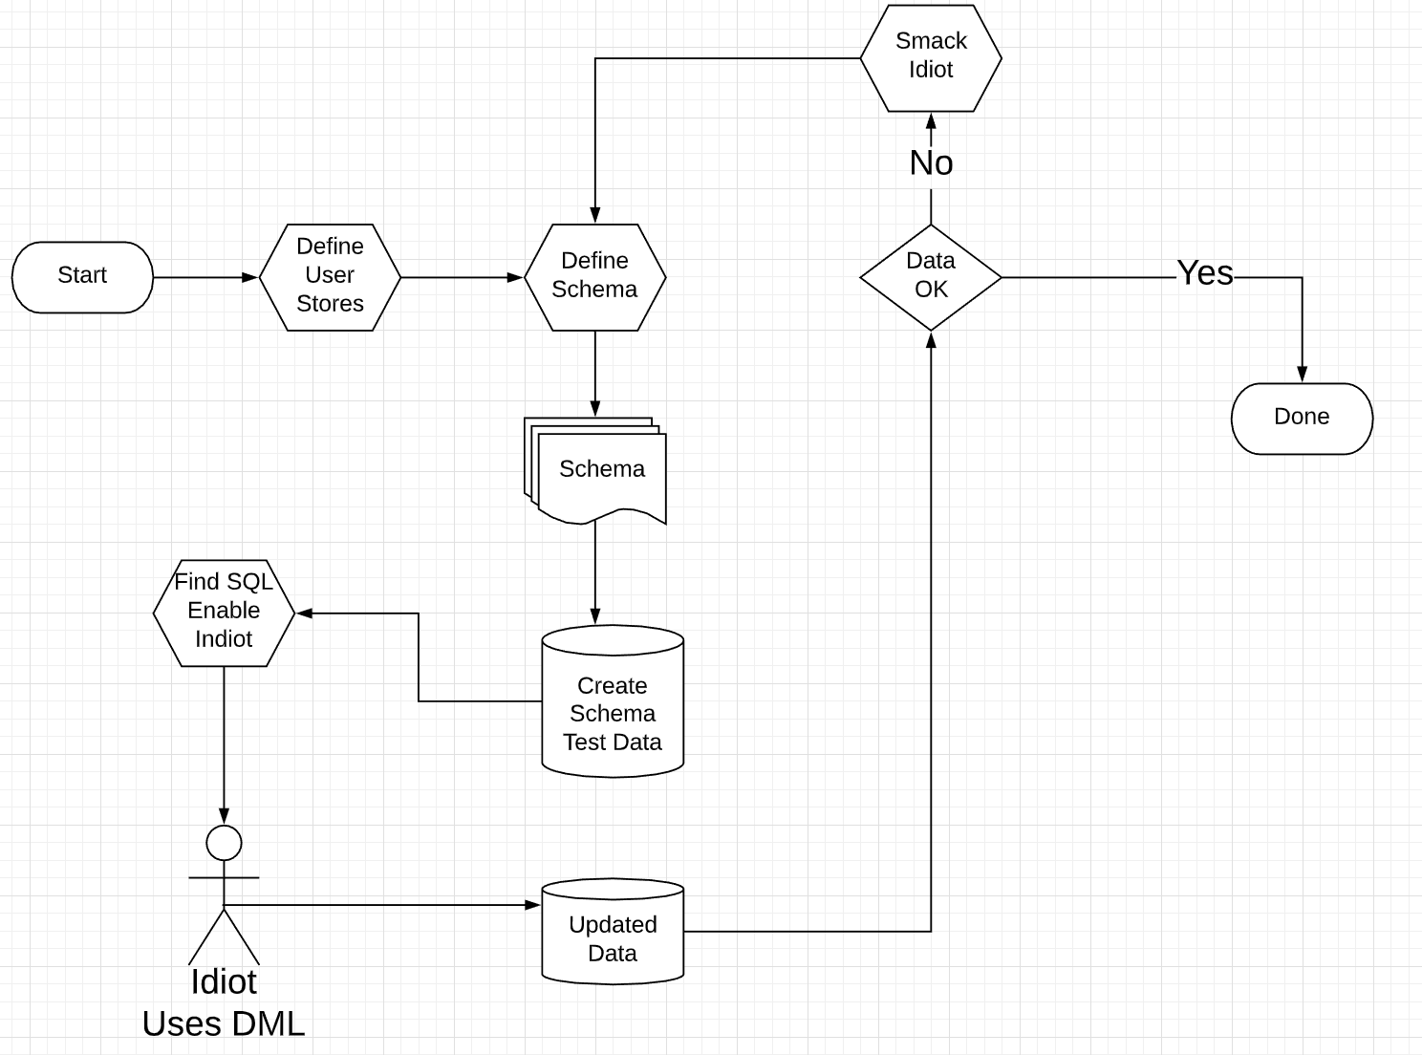
U-FLUNK is a Workflow Process

Slide 36
Denormalization for Performance
May want to use non-normalized schema for performance
For example, displaying prereqs along with course_id, and title requires join of course with prereq
Alternative 1: Use denormalized relation containing attributes of course as well as prereq with all above attributes
faster lookup
extra space and extra execution time for updates
extra coding work for programmer and possibility of error in extra code
Alternative 2: use a materialized view defined a course prereq
Benefits and drawbacks same as above, except no extra coding work for programmer and avoids possible errors

Slide 37
First Normal Form
Domain is atomic if its elements are considered to be indivisible units
Examples of non-atomic domains:
Set of names, composite attributes
Identification numbers like CS 101 that can be broken up into parts
A relational schema R is in first normal form if the domains of all attributes of R are atomic
Non-atomic values complicate storage and encourage redundant (repeated) storage of data
Example: Set of accounts stored with each customer, and set of owners stored with each account
We assume all relations are in first normal form (and revisit this in Chapter 22: Object Based Databases)

Slide 38
First Normal Form (Cont.)
Atomicity is actually a property of how the elements of the domain are used.
Example: Strings would normally be considered indivisible
Suppose that students are given roll numbers which are strings of the form CS0012 or EE1127
If the first two characters are extracted to find the department, the domain of roll numbers is not atomic.
Doing so is a bad idea: leads to encoding of information in application program rather than in the database.

Slide 39
“2021-04-02”
101, 102
1*10 + 2*1
$1,203 (x, y), (0,203)
1: 19000101
2: 19000102
21034
Number_to_date(n) → “20210402”
Date_str_to_number(“19000101”) 1
19000101, 190200101: n,m
(“2021-04-02”, p01, 3, $1)
Show me total revenue broken by
(product number, year)
(# of sales, day of week)
(total revenue, month, day of week)
(... ... ...)
23315
2021-04-02
Year,
Day of week
Day of the month
Quarter
Weekend
... ...

Slide 40
Transactions Isolation Recovery

Slide 41
Core Concepts
Transactions Isolation Recovery

Slide 42

Data Management
Find things quickly.
Load/Save quickly.
Control access (Isolation)
Durability
Database Systems: The Complete Book (2nd Edition) by Hector Garcia-Molina (Author), Jeffrey D. Ullman (Author), Jennifer Widom (Author)

Slide 43
Core Transaction Concept is ACID Properties
http://slideplayer.com/slide/9307681
ACID
Atomic
“ALL OR NOTHING”
Transaction cannot be subdivided
Consistent
Transaction → transforms database from one consistent state to another consistent state
Isolated
Transactions execute independently of one another
Database changes not revealed to users until after transaction has completed
Durable
Database changes are permanent
The permanence of the database’s consistent state

Slide 44
ACID Properties (httpwww.tutorialspoint.com/dbms/dbms_transaction.htm)
A transaction is a very small unit of a program and it may contain several low-level tasks. A transaction in a database system must maintain Atomicity, Consistency, Isolation, and Durability − commonly known as ACID properties − in order to ensure accuracy, completeness, and data integrity.
Atomicity − This property states that a transaction must be treated as an atomic unit, that is, either all of its operations are executed or none. There must be no state in a database where a transaction is left partially completed. States should be defined either before the execution of the transaction or after the execution/abortion/failure of the transaction.
Consistency − The database must remain in a consistent state after any transaction. No transaction should have any adverse effect on the data residing in the database. If the database was in a consistent state before the execution of a transaction, it must remain consistent after the execution of the transaction as well.
Durability − The database should be durable enough to hold all its latest updates even if the system fails or restarts. If a transaction updates a chunk of data in a database and commits, then the database will hold the modified data. If a transaction commits but the system fails before the data could be written on to the disk, then that data will be updated once the system springs back into action.
Isolation − In a database system where more than one transaction are being executed simultaneously and in parallel, the property of isolation states that all the transactions will be carried out and executed as if it is the only transaction in the system. No transaction will affect the existence of any other transaction.

Slide 45
Transaction Concept
A transaction is a unit of program execution that accesses and possibly updates various data items.
E.g., transaction to transfer $50 from account A to account B:
BEGIN TRANSACTION {
1. read(A)
2. A := A – 50
write(A)
4. read(B)
5. B := B + 50
write(B)
COMMIT or ROLLBACK }
Two main issues to deal with:
Failures of various kinds, such as hardware failures and system crashes
Concurrent execution of multiple transactions
BEGIN TRANSACTION {
1. read(A)
2. A := A – 50
write(A)
4. read(B)
5. B := B + 50
write(B)
COMMIT or ROLLBACK }

Slide 46
Example of Fund Transfer
T
Transaction to transfer $50 from account A to account B:
1. read(A)
2. A := A – 50
3. write(A)
4. read(B)
5. B := B + 50
6. write(B)
Atomicity requirement
If the transaction fails after step 3 and before step 6, money will be “lost” leading to an inconsistent database state
Failure could be due to software or hardware
The system should ensure that updates of a partially executed transaction are not reflected in the database
Durability requirement — once the user has been notified that the transaction has completed (i.e., the transfer of the $50 has taken place), the updates to the database by the transaction must persist even if there are software or hardware failures.
B
C

Slide 47
Example of Fund Transfer (Cont.)
Consistency requirement in above example:
The sum of A and B is unchanged by the execution of the transaction
In general, consistency requirements include
Explicitly specified integrity constraints such as primary keys and foreign keys
Implicit integrity constraints
e.g., sum of balances of all accounts, minus sum of loan amounts must equal value of cash-in-hand
A transaction must see a consistent database.
During transaction execution the database may be temporarily inconsistent.
When the transaction completes successfully the database must be consistent
Erroneous transaction logic can lead to inconsistency

Slide 48
Example of Fund Transfer (Cont.)
Isolation requirement — if between steps 3 and 6, another transaction T2 is allowed to access the partially updated database, it will see an inconsistent database (the sum A + B will be less than it should be).
T1 T2
1. read(A)
2. A := A – 50
write(A) read(A)
read(B) print(A+B)
4. read(B)
5. B := B + 50
6. write(B)
Isolation can be ensured trivially by running transactions serially
That is, one after the other.
However, executing multiple transactions concurrently has significant benefits, as we will see later.
T1, T2
T1
T2

Slide 49
ACID Properties
A transaction is a unit of program execution that accesses and possibly updates various data items. To preserve the integrity of data the database system must ensure:
Atomicity. Either all operations of the transaction are properly reflected in the database or none are.
Consistency. Execution of a transaction in isolation preserves the consistency of the database.
Isolation. Although multiple transactions may execute concurrently, each transaction must be unaware of other concurrently executing transactions. Intermediate transaction results must be hidden from other concurrently executed transactions.
That is, for every pair of transactions T_{i} and T_{j}, it appears to T_{i} that either T_{j}, finished execution before T_{i} started, or T_{j} started execution after T_{i} finished.
Durability. After a transaction completes successfully, the changes it has made to the database persist, even if there are system failures.

Slide 50
Transaction State
Active – the initial state; the transaction stays in this state while it is executing
Partially committed – after the final statement has been executed.
Failed -- after the discovery that normal execution can no longer proceed.
Aborted – after the transaction has been rolled back and the database restored to its state prior to the start of the transaction. Two options after it has been aborted:
Restart the transaction
Can be done only if no internal logical error
Kill the transaction
Committed – after successful completion.

Slide 51

Atomicity Durability
51 | Introduction to Databases (S21): Lecture 11: Normalization, Transactions
© Donald F. Ferguson, 2020

Slide 52
Atomicity
A transaction is a logical unit of work that must be either entirely completed or entirely undone. (All writes happen or none of them happen)
OK. What does this mean? Consider some pseudo-code
def transfer(source_acct_id, target_acct_id, amount)
Check that both accounts exist.
IF is_checking_account(source_acct_id)
Check that (source_acct.balance-amount) > source_account.overdraft_limit
ELSE
Check that (source_count.balance-amount) >source_account.minimum_balance
Update source account
Update target account.
INSERT a record into transfer tracking table.

Slide 53
Atomicity
A transaction is a logical unit of work that must be either entirely completed or entirely undone. (All writes happen or none of them happen)
OK. What does this mean? Consider some pseudo-code
def transfer(source_acct_id, target_acct_id, amount)
Check that both accounts exist.
IF is_checking_account(source_acct_id)
Check that (source_acct.balance-amount) > source_account.overdraft_limit
ELSE
Check that (source_count.balance-amount) >source_account.minimum_balance
Update source account
Update target account.
INSERT a record into transfer tracking table.
Computer or DB Server fails.

Slide 54
Atomicty
Transaction programs and databases are fast (milliseconds). What are the chances of the failure occurring in the wrong spot?
Well, that doesn’t really matter. If it happens,
Someone lost money and
There is no record off it. Someone is going to very upset.
Even a small server can have thousands of concurrent transactions ➔
There will be corruptions because some transaction will be in the wrong place at the wrong time.
Unless we do something in the DBMS
Because HW and software inevitably fail
And sadly, SW is especially prone to failure when under load

Slide 55
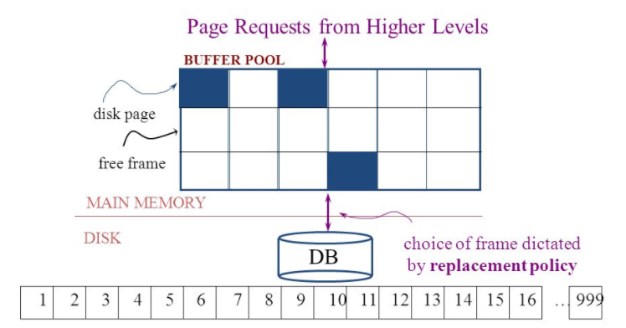
Simplistic Approach
Begin
Update A
Update B
Update C
Commit (REQ)
Force to disk
Commit (RSP)

Slide 56
Simplistic Approach
There are several problems with the simplistic approach.
The approach does not solve the problem
Some writes might succeed.
Some might be interrupted by the failure, or require retry.
Writes may be random and scattered. N updates might
Change a few bytes in N data frames
A few bytes in M index frames
Transaction rate becomes bottlenecked by write I/O rate, even though a relative small number of bytes change/transaction.
Written frames must be held in memory.
Lots of transactions
Randomly writing small pieces of lots of frames.
Consumes lots of memory with pinned pages.
Degrades the performance and optimization of the buffer.
The optimal buffer replacement policy wants to hold frames that will be reused.
Not frames that have been touched and never reused.

Slide 57
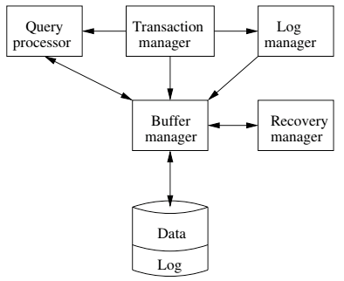
DBMS ACID Implementation
Implementation Subsystems
Query processor schedules and executes queries.
Buffer manager controls reading/writing blocks/frames to/from disk.
Log manager journals/records events to disk (log), e.g.
Transaction start/commit/abort
Transaction update of a block and previous value of data.
Transaction manager coordinates query scheduling, buffer read/write and logging to ensure ACID.
Recovery manager processes log to ensure ACID even after transaction or system failures.
Log is a special type of block file used by the system to optimize performance and ensure ACID.
Garcia-Molina et al., p. 846

Slide 58
Logging
The DBMS logs every transaction event
Log Sequence Number (LSN): A unique ID for a log record.
Prev LSN: A link to their last log record.
Transaction ID number.
Type: Describes the type of database log record.
Update Log Record
PageID: A reference to the Page ID of the modified page.
Length and Offset: Length in bytes and offset of the page are usually included.
Before and After Images of records.
Compensation Log Record
Commit Record
Abort Record Checkpoint Record
Completion Record notes that all work has been done for this particular transaction.

Slide 59
Write Ahead Logging
DBMS (Redo processing)
Write log events from all transactions into a single log stream.
Multiple events per page
Forces (writes) log record on COMMIT/ABORT
Single block I/O records many updates
Versus multiple block I/Os, each recording a single change.
All of a transaction’s updates recorded in one I/O versus many.
If there is a failure
DBMS sequentially reads log.
Applies changes to modified pages that were not saved to disk.
Then resumes normal processing.
Begin
Update A
Update B
Update C
Commit (REQ)
Force to disk
Commit (RSP)
Log

Slide 60
Write Ahead Logging
Force every write to disk?
Poor response time.
But provides durability.
Steal buffer-pool frames from uncommitted transactions?
If not, poor performance/caching performance
If yes, how can we ensure atomicity? Uncommitted updates on disk
DBMS (Undo processing)
Enable steal policy to improve cache performance by
Avoiding lots of pinned pages
Unlikely to be reused soon.
Before stealing
Force log record to disk.
Update log entry has data record
Before image
After image
If there is a failure
DBMS sequentially reads log.
Undoes changes to
modified pages, uncommitted pages
That were saved to disk.
Then resumes normal processing.
No Steal
Steal
Force
Trivial
No Force
Desired

Slide 61
ARIES Algorithm = Algorithms for Recovery and Isolation Exploiting Semantics
ARIES recovery involves three passes
Analysis pass:
Determine which transactions to undo
Determine which pages were dirty (disk version not up to date) at time of
RedoLSN: LSN from which redo should start
Redo pass:
Repeats history, redoing all actions from RedoLSN (updated committed but not written changes to pages)
RecLSN and PageLSNs are used to avoid redoing actions already reflected on page
Undo pass:
Rolls back all incomplete transactions (with uncommitted pages written to disk).
Transactions whose abort was complete earlier are not undone

Slide 62
Durability
Write changes to disk trivially achieves durability.
DBMS engine uses write-ahead-logging to
Achieve durability
But with better performance through more efficient caching and I/O.
Well, disks fail. How is that durable.
RAID and other solutions.
Disk subsystems, including entire RAID device, fail →
Duplex writes
To independent disk subsystems.
Well, there are earthquakes, floods, etc.

Slide 63
Availability and Replication
There are two basic patterns
Active/Passive
All requests go to master during normal processing.
Updates are transactionally queued for processing at passive backup.
Failure of master
Routes subsequent requests to backup.
Backup must process and commit updates before accepting requests.
Active/Active
Both environments process requests.
Some form of distributed transaction commit required to synchronize updates on both copies.
Multi-system communication to guarantee consistency is the foundation for tradeoffs in CAP.
The system can be CAP if and only iff
There are never any partitions or system failures
Which is unrealistic in cloud/Internet systems.

Slide 64
Isolation
64 | Introduction to Databases (S21): Lecture 11: Normalization, Transactions
© Donald F. Ferguson, 2020

Slide 65
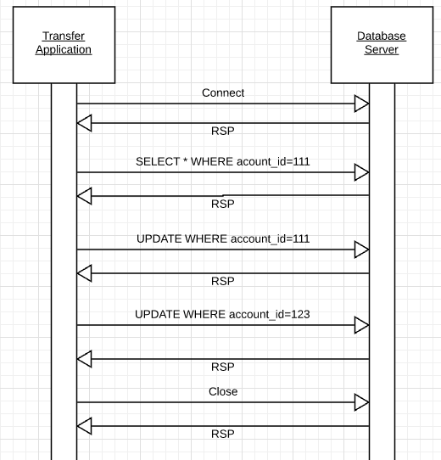
Isolation
Transfer $50 from
account_id=111 to
account_id=123
Requires 3 SQL statements
SELECT from 111 to check balance >= $50
UPDATE account_id=111
UPDATE account_id=123
There are some interesting scenarios
Two different programs read the balance ($51)
And decide removing $50 is OK.
DB constraints can prevent the conflict from happening, but …
There are more complex scenarios that constraints do not prevent.
Not ALL databases support constraints.
The “correct” execution should be that
One transaction responds “insufficient funds”
Before attempting transfer instead of after attempting.
Multiple readers

Slide 66
Isolation
Consider two simultaneous transfer transactions T1 and T2.
There are two equally correct executions
T1 transfers, T2 responds “insufficient funds” and does not attempt transfer
T2 transfers, T1 responds “insufficient funds” and does not attempt transfer
Each correct simultaneous execution is equivalent to a serial (sequential) execution schedule
(1) Execute T1, Execute T2
(2) Execute T2, Execute T1
NOTE:
We are focusing on correctness not
Fairness:
We do not care which transaction was actually submitted first.
And probably do not know due to networking, etc.
Transfer $50 from
account_id=111 to
account_id=123
Requires 3 SQL statements
SELECT from 111 to check balance >= $50
UPDATE account_id=111
UPDATE account_id=123
There are some interesting scenarios
Two different programs read the balance ($51)
And decide removing $50 is OK.
DB constraints can prevent the conflict from happening, but …
There are more complex scenarios that constraints do not prevent.
Not ALL databases support constraints.
The “correct” execution should be that
One transaction responds “insufficient funds”
Before attempting transfer instead of after attempting.
Multiple readers

Slide 67
Serializability
“In concurrency control of databases,^{[1][2]} transaction processing (transaction management), and various transactional applications (e.g., transactional memory^{[3]} and software transactional memory), both centralized and distributed, a transaction schedule is serializable if its outcome (e.g., the resulting database state) is equal to the outcome of its transactions executed serially, i.e. without overlapping in time. Transactions are normally executed concurrently (they overlap), since this is the most efficient way. Serializability is the major correctness criterion for concurrent transactions' executions. It is considered the highest level of isolation between transactions, and plays an essential role in concurrency control. As such it is supported in all general purpose database systems.” (https://en.wikipedia.org/wiki/Serializability)

Slide 68
DBMS ACID Implementation
Implementation Subsystems
Query processor schedules and executes queries.
Buffer manager controls reading/writing blocks/frames to/from disk.
Log manager journals/records events to disk (log), e.g.
Transaction start/commit/abort
Transaction update of a block and previous value of data.
Transaction manager coordinates query scheduling, buffer read/write and logging to ensure ACID.
Recovery manager processes log to ensure ACID even after transaction or system failures.
Log is a special type of block file used by the system to optimize performance and ensure ACID.
Garcia-Molina et al., p. 846

Slide 69
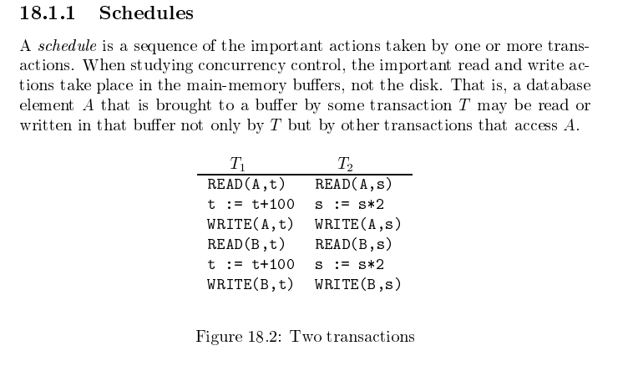
Schedule
Garcia-Molina et al.

Slide 70
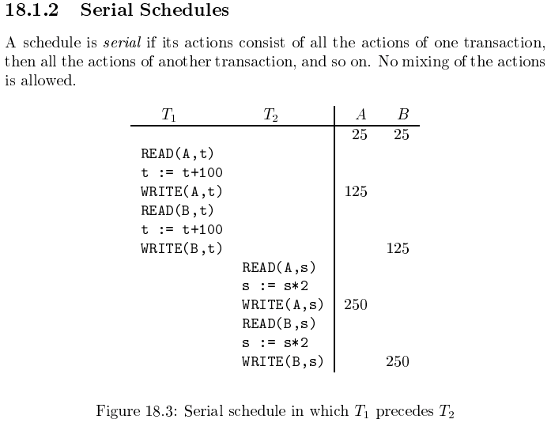
Serializable
Assume there are three
concurrently executing transactions
T1, T2 and T3
The transaction manager
Enables concurrent execution
But schedules individual operations
To ensure that the final DB state
Is equivalent to one of the following schedules
T1, T2, T3
T1, T3, T2
T2, T1, T3
T2, T3, T1
T3, T1, T2
T3, T2, T1
Concurrent execution was serializable.

Slide 71
Serializability (en.wikipedia.org/wiki/Serializability)
Serializability is used to keep the data in the data item in a consistent state. Serializability is a property of a transaction schedule (history). It relates to the isolation property of a database transaction.
Serializability of a schedule means equivalence (in the outcome, the database state, data values) to a serial schedule (i.e., sequential with no transaction overlap in time) with the same transactions. It is the major criterion for the correctness of concurrent transactions' schedule, and thus supported in all general purpose database systems.
The rationale behind serializability is the following:
If each transaction is correct by itself, i.e., meets certain integrity conditions,
then a schedule that comprises any serial execution of these transactions is correct (its transactions still meet their conditions):
"Serial" means that transactions do not overlap in time and cannot interfere with each other, i.e, complete isolation between each other exists.
Any order of the transactions is legitimate, (…)
As a result, a schedule that comprises any execution (not necessarily serial) that is equivalent (in its outcome) to any serial execution of these transactions, is correct.

Slide 72
Lock-Based Concurrency Control
Strict Two-phase Locking (Strict 2PL) Protocol:
Each Xact must obtain a S (shared) lock on object before reading, and an X (exclusive) lock on object before writing.
All locks held by a transaction are released when the transaction completes
(Non-strict) 2PL Variant: Release locks anytime, but cannot acquire locks after releasing any lock.
If an Xact holds an X lock on an object, no other Xact can get a lock (S or X) on that object.
Strict 2PL allows only serializable schedules.
Additionally, it simplifies transaction aborts
(Non-strict) 2PL also allows only serializable schedules, but involves more complex abort processing

Slide 73
Aborting a Transaction
If a transaction Ti is aborted, all its actions have to be undone. Not only that, if Tj reads an object last written by Ti, Tj must be aborted as well!
Most systems avoid such cascading aborts by releasing a transaction’s locks only at commit time.
If Ti writes an object, Tj can read this only after Ti commits.
In order to undo the actions of an aborted transaction, the DBMS maintains a log in which every write is recorded. This mechanism is also used to recover from system crashes: all active Xacts at the time of the crash are aborted when the system comes back up.

Slide 74
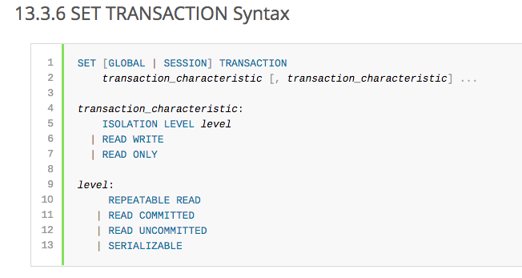
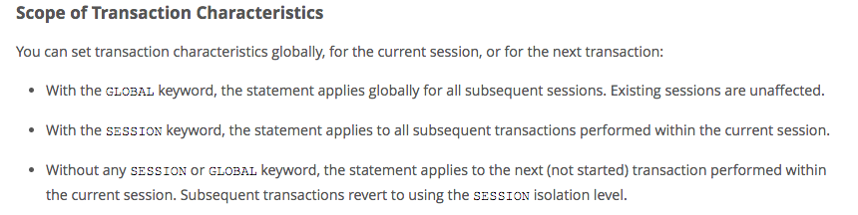
MySQL (Locking) Isolation

Slide 75
Isolation Levels (https://en.wikipedia.org/wiki/Isolation_(database_systems)
Not all transaction use cases require 2PL and serializable execution. Databases support a a set of levels.
Serializable
With a lock-based concurrency control DBMS implementation, serializability requires read and write locks (acquired on selected data) to be released at the end of the transaction. Also range-locks must be acquired when a SELECT query uses a ranged WHERE clause, especially to avoid the phantom reads phenomenon.
The execution of concurrent SQL-transactions at isolation level SERIALIZABLE is guaranteed to be serializable. A serializable execution is defined to be an execution of the operations of concurrently executing SQL-transactions that produces the same effect as some serial execution of those same SQL-transactions. A serial execution is one in which each SQL-transaction executes to completion before the next SQL-transaction begins.
Repeatable reads
In this isolation level, a lock-based concurrency control DBMS implementation keeps read and write locks (acquired on selected data) until the end of the transaction. However, range-locks are not managed, so phantom reads can occur.
Write skew is possible at this isolation level, a phenomenon where two writes are allowed to the same column(s) in a table by two different writers (who have previously read the columns they are updating), resulting in the column having data that is a mix of the two transactions.^{[3][4]}
Read committed
In this isolation level, a lock-based concurrency control DBMS implementation keeps write locks (acquired on selected data) until the end of the transaction, but read locks are released as soon as the SELECT operation is performed (so the non-repeatable reads phenomenon can occur in this isolation level). As in the previous level, range-locks are not managed.
Putting it in simpler words, read committed is an isolation level that guarantees that any data read is committed at the moment it is read. It simply restricts the reader from seeing any intermediate, uncommitted, 'dirty' read. It makes no promise whatsoever that if the transaction re-issues the read, it will find the same data; data is free to change after it is read.
Read uncommitted
This is the lowest isolation level. In this level, dirty reads are allowed, so one transaction may see not-yet-committed changes made by other transactions

Slide 76
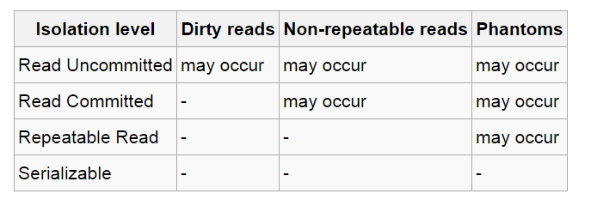
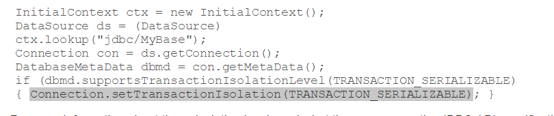
In Databases, Cursors Define Isolation
We have talked about ACID transactions
Atomic: A set of writes all occur or none occur.
Durable: The data “does not disappear,” e.g. write to disk.
Consistent: My applications move the database between consistent states, e.g. the transfer function works correctly.
Isolation
Determines what happens when two or more threads are manipulating the data at the same time.
And is defined relative to where cursors are and what they have touched.
Because the cursor movement determines what you are reading or have read.
But, … Cursors are client conversation state and cannot be used in REST.

Slide 77
Decision Support

Slide 78
Isolation

Slide 79
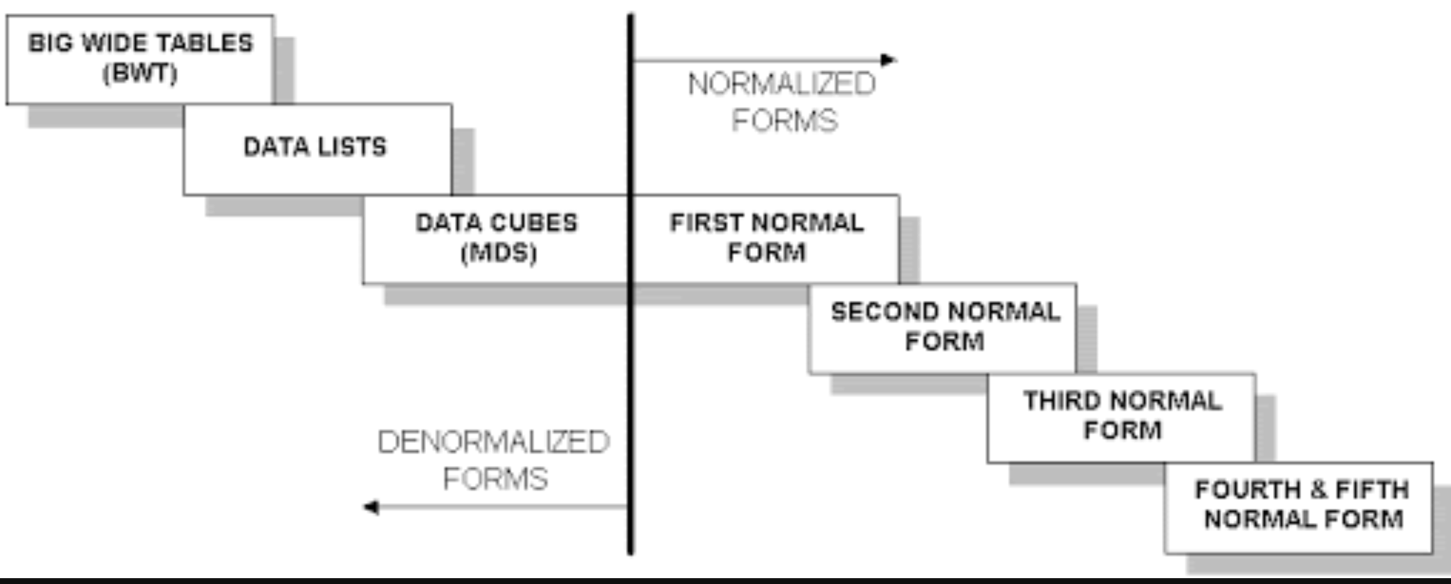
Wide Flat Tables
Good for Integrity
Good for Query
Improve query performance by precomputing and saving:
JOINs
Aggregation
Derived/computed columns
One of the primary strength of the relational model is maintaining “integrity” when applications create, update and delete data. This relies on:
The core capabilities of the relational model, e.g. constraints.
A well-design database (We will cover a formal definition – “normalization” in more detail later.
Data models that are well designed for integrity are very bad for read only analysis queries. We will build and analyze wide flat tables as part of the analysis tasks in HW3, HW4 as projects.

Slide 80
Chapter 20: Data Analysis

Slide 81
Chapter 20: Data Analysis
Decision Support Systems
Data Warehousing
Data Mining
Classification
Association Rules
Clustering

Slide 82
Decision Support Systems
Decision-support systems are used to make business decisions, often based on data collected by on-line transaction-processing systems.
Examples of business decisions:
What items to stock?
What insurance premium to change?
To whom to send advertisements?
Examples of data used for making decisions
Retail sales transaction details
Customer profiles (income, age, gender, etc.)

Slide 83
Decision-Support Systems: Overview
Data analysis tasks are simplified by specialized tools and SQL extensions
Example tasks
For each product category and each region, what were the total sales in the last quarter and how do they compare with the same quarter last year
As above, for each product category and each customer category
Statistical analysis packages (e.g., : S++) can be interfaced with databases
Statistical analysis is a large field, but not covered here
Data mining seeks to discover knowledge automatically in the form of statistical rules and patterns from large databases.
A data warehouse archives information gathered from multiple sources, and stores it under a unified schema, at a single site.
Important for large businesses that generate data from multiple divisions, possibly at multiple sites
Data may also be purchased externally

Slide 84
Data Warehousing
Data sources often store only current data, not historical data
Corporate decision making requires a unified view of all organizational data, including historical data
A data warehouse is a repository (archive) of information gathered from multiple sources, stored under a unified schema, at a single site
Greatly simplifies querying, permits study of historical trends
Shifts decision support query load away from transaction processing systems

Slide 85
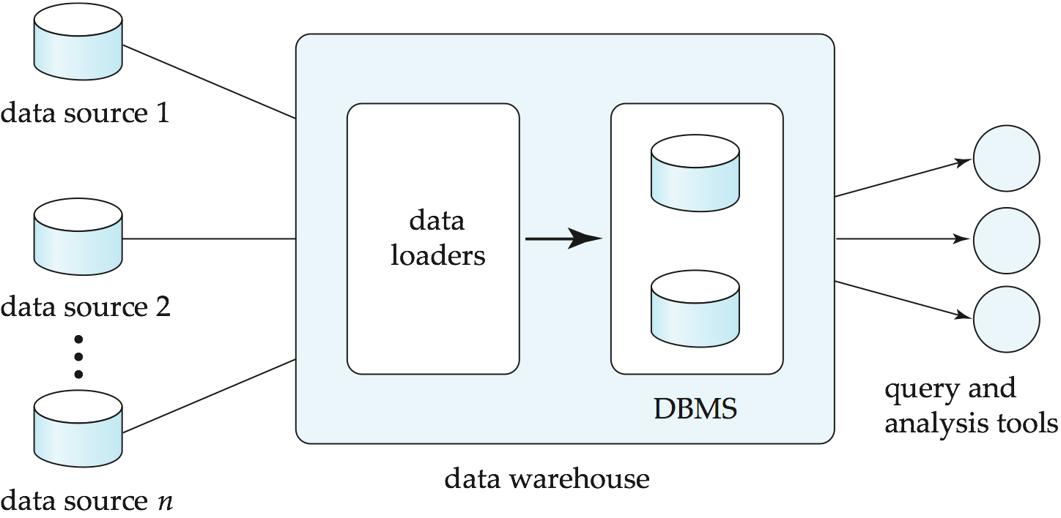
Data Warehousing

Slide 86
Design Issues
When and how to gather data
Source driven architecture: data sources transmit new information to warehouse, either continuously or periodically (e.g., at night)
Destination driven architecture: warehouse periodically requests new information from data sources
Keeping warehouse exactly synchronized with data sources (e.g., using two-phase commit) is too expensive
Usually OK to have slightly out-of-date data at warehouse
Data/updates are periodically downloaded form online transaction processing (OLTP) systems.
What schema to use
Schema integration

Slide 87
More Warehouse Design Issues
Data cleansing
E.g., correct mistakes in addresses (misspellings, zip code errors)
Merge address lists from different sources and purge duplicates
How to propagate updates
Warehouse schema may be a (materialized) view of schema from data sources
What data to summarize
Raw data may be too large to store on-line
Aggregate values (totals/subtotals) often suffice
Queries on raw data can often be transformed by query optimizer to use aggregate values

Slide 88
Warehouse Schemas
Dimension values are usually encoded using small integers and mapped to full values via dimension tables
Resultant schema is called a star schema
More complicated schema structures
Snowflake schema: multiple levels of dimension tables
Constellation: multiple fact tables

Slide 89
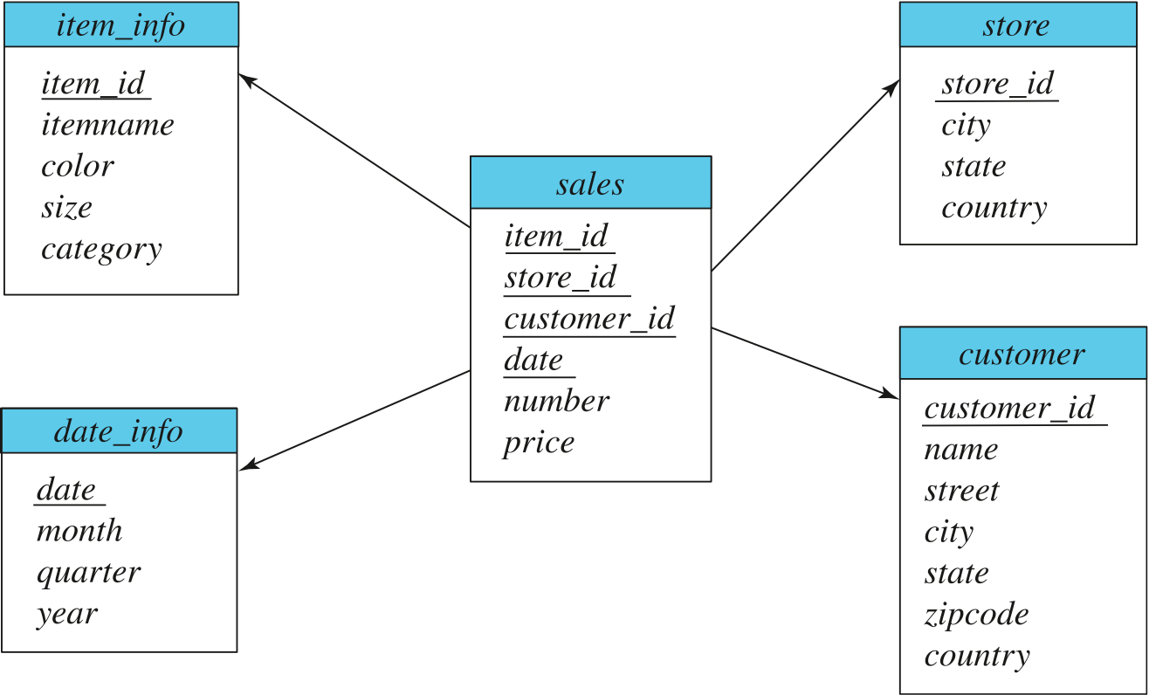
Data Warehouse Schema

Slide 90
Worked Example Classic Models

Slide 91
Classic Models
This schema is “good” relative
To normalization.
Avoiding update anomalies.
Common, intuitive decision support and insight queries require a lot of
JOINs
Aggregates
... ...
These operations are slow and can interfere with operational transactions.
We will look at some transformation to a decision support schema.

Slide 92
Go To Notebook

Slide 93
Transaction Details (Skip, but students to read)

Slide 94
Transaction State (Cont.)

Slide 95
Concurrent Executions
Multiple transactions are allowed to run concurrently in the system. Advantages are:
Increased processor and disk utilization, leading to better transaction throughput
E.g., one transaction can be using the CPU while another is reading from or writing to the disk
Reduced average response time for transactions: short transactions need not wait behind long ones.
Concurrency control schemes – mechanisms to achieve isolation
That is, to control the interaction among the concurrent transactions in order to prevent them from destroying the consistency of the database
Will study in Chapter 15, after studying notion of correctness of concurrent executions.

Slide 96
Schedules
Schedule – a sequences of instructions that specify the chronological order in which instructions of concurrent transactions are executed
A schedule for a set of transactions must consist of all instructions of those transactions
Must preserve the order in which the instructions appear in each individual transaction.
A transaction that successfully completes its execution will have a commit instructions as the last statement
By default transaction assumed to execute commit instruction as its last step
A transaction that fails to successfully complete its execution will have an abort instruction as the last statement

Slide 97
Schedule 1
Let T₁ transfer $50 from A to B, and T₂ transfer 10% of the balance from A to B.
A serial schedule in which T₁ is followed by T₂ :

Slide 98
Schedule 2
A serial schedule where T₂ is followed by T₁

Slide 99
Schedule 3
Let T₁ and T₂ be the transactions defined previously. The following schedule is not a serial schedule, but it is equivalent to Schedule 1
In Schedules 1, 2 and 3, the sum A + B is preserved.

Slide 100
Schedule 4
The following concurrent schedule does not preserve the value of (A + B ).

Slide 101
Serializability
Basic Assumption – Each transaction preserves database consistency.
Thus, serial execution of a set of transactions preserves database consistency.
A (possibly concurrent) schedule is serializable if it is equivalent to a serial schedule. Different forms of schedule equivalence give rise to the notions of:
1. Conflict serializability
2. View serializability

Slide 102
Simplified view of transactions
We ignore operations other than read and write instructions
We assume that transactions may perform arbitrary computations on data in local buffers in between reads and writes.
Our simplified schedules consist of only read and write instructions.

Slide 103
Conflicting Instructions
Instructions l_{i} and l_{j} of transactions T_{i} and T_{j} respectively, conflict if and only if there exists some item Q accessed by both l_{i} and l_{j}, and at least one of these instructions wrote Q.
1. l_{i} = read(Q), l_{j} = read(Q). l_{i} and l_{j} don’t conflict. 2. l_{i} = read(Q), l_{j} = write(Q). They conflict. 3. l_{i} = write(Q), l_{j} = read(Q). They conflict 4. l_{i} = write(Q), l_{j} = write(Q). They conflict
Intuitively, a conflict between l_{i} and l_{j} forces a (logical) temporal order between them.
If l_{i} and l_{j} are consecutive in a schedule and they do not conflict, their results would remain the same even if they had been interchanged in the schedule.

Slide 104
Conflict Serializability
If a schedule S can be transformed into a schedule S’ by a series of swaps of non-conflicting instructions, we say that S and S’ are conflict equivalent.
We say that a schedule S is conflict serializable if it is conflict equivalent to a serial schedule

Slide 105
Conflict Serializability (Cont.)
Schedule 3 can be transformed into Schedule 6, a serial schedule where T₂ follows T₁, by series of swaps of non-conflicting instructions. Therefore Schedule 3 is conflict serializable.
Schedule 3
Schedule 6

Slide 106
Conflict Serializability (Cont.)
Example of a schedule that is not conflict serializable:
We are unable to swap instructions in the above schedule to obtain either the serial schedule < T₃, T₄ >, or the serial schedule < T₄, T₃ >.

Slide 107
View Serializability
Let S and S’ be two schedules with the same set of transactions. S and S’ are view equivalent if the following three conditions are met, for each data item Q,
1. If in schedule S, transaction T_{i} reads the initial value of Q, then in
schedule S’ also transaction T_{i} must read the initial value of Q.
2. If in schedule S transaction T_{i} executes read(Q), and that value was
produced by transaction T_{j} (if any), then in schedule S’ also
transaction T_{i} must read the value of Q that was produced by the
same write(Q) operation of transaction T_{j} .
3. The transaction (if any) that performs the final write(Q) operation in
schedule S must also perform the final write(Q) operation in schedule S’.
As can be seen, view equivalence is also based purely on reads and writes alone.

Slide 108
View Serializability (Cont.)
A schedule S is view serializable if it is view equivalent to a serial schedule.
Every conflict serializable schedule is also view serializable.
Below is a schedule which is view-serializable but not conflict serializable.
What serial schedule is above equivalent to?
Every view serializable schedule that is not conflict serializable has blind writes.

Slide 109
Other Notions of Serializability
The schedule below produces same outcome as the serial schedule < T₁, T₅ >, yet is not conflict equivalent or view equivalent to it.
Determining such equivalence requires analysis of operations other than read and write.

Slide 110
Testing for Serializability
Consider some schedule of a set of transactions T₁, T₂, ..., T_{n}
Precedence graph — a direct graph where the vertices are the transactions (names).
We draw an arc from T_{i} to T_{j} if the two transaction conflict, and T_{i} accessed the data item on which the conflict arose earlier.
We may label the arc by the item that was accessed.
Example of a precedence graph

Slide 111
Test for Conflict Serializability
A schedule is conflict serializable if and only if its precedence graph is acyclic.
Cycle-detection algorithms exist which take order n² time, where n is the number of vertices in the graph.
(Better algorithms take order n + e where e is the number of edges.)
If precedence graph is acyclic, the serializability order can be obtained by a topological sorting of the graph.
This is a linear order consistent with the partial order of the graph.
For example, a serializability order for Schedule A would be T₅ → T₁ → T₃ → T₂ → T₄
Are there others?

Slide 112
Test for View Serializability
The precedence graph test for conflict serializability cannot be used directly to test for view serializability.
Extension to test for view serializability has cost exponential in the size of the precedence graph.
The problem of checking if a schedule is view serializable falls in the class of NP-complete problems.
Thus, existence of an efficient algorithm is extremely unlikely.
However practical algorithms that just check some sufficient conditions for view serializability can still be used.

Slide 113
Recoverable Schedules
Need to address the effect of transaction failures on concurrently running transactions.
Recoverable schedule — if a transaction T_{j} reads a data item previously written by a transaction T_{i} , then the commit operation of T_{i} appears before the commit operation of T_{j}.
The following schedule (Schedule 11) is not recoverable
If T₈ should abort, T₉ would have read (and possibly shown to the user) an inconsistent database state. Hence, database must ensure that schedules are recoverable.

Slide 114
Cascading Rollbacks
Cascading rollback – a single transaction failure leads to a series of transaction rollbacks. Consider the following schedule where none of the transactions has yet committed (so the schedule is recoverable) If T₁₀ fails, T₁₁ and T₁₂ must also be rolled back.
Can lead to the undoing of a significant amount of work

Slide 115
Cascadeless Schedules
Cascadeless schedules — cascading rollbacks cannot occur;
For each pair of transactions T_{i} and T_{j} such that T_{j} reads a data item previously written by T_{i}, the commit operation of T_{i} appears before the read operation of T_{j}.
Every Cascadeless schedule is also recoverable
It is desirable to restrict the schedules to those that are cascadeless

Slide 116
Concurrency Control
A database must provide a mechanism that will ensure that all possible schedules are
either conflict or view serializable, and
are recoverable and preferably cascadeless
A policy in which only one transaction can execute at a time generates serial schedules, but provides a poor degree of concurrency
Are serial schedules recoverable/cascadeless?
Testing a schedule for serializability after it has executed is a little too late!
Goal – to develop concurrency control protocols that will assure serializability.

Slide 117
Concurrency Control (Cont.)
Schedules must be conflict or view serializable, and recoverable, for the sake of database consistency, and preferably cascadeless.
A policy in which only one transaction can execute at a time generates serial schedules, but provides a poor degree of concurrency.
Concurrency-control schemes tradeoff between the amount of concurrency they allow and the amount of overhead that they incur.
Some schemes allow only conflict-serializable schedules to be generated, while others allow view-serializable schedules that are not conflict-serializable.

Slide 118
Concurrency Control vs. Serializability Tests
Concurrency-control protocols allow concurrent schedules, but ensure that the schedules are conflict/view serializable, and are recoverable and cascadeless .
Concurrency control protocols (generally) do not examine the precedence graph as it is being created
Instead a protocol imposes a discipline that avoids non-serializable schedules.
We study such protocols in Chapter 16.
Different concurrency control protocols provide different tradeoffs between the amount of concurrency they allow and the amount of overhead that they incur.
Tests for serializability help us understand why a concurrency control protocol is correct.

Slide 119
Weak Levels of Consistency
Some applications are willing to live with weak levels of consistency, allowing schedules that are not serializable
E.g., a read-only transaction that wants to get an approximate total balance of all accounts
E.g., database statistics computed for query optimization can be approximate (why?)
Such transactions need not be serializable with respect to other transactions
Tradeoff accuracy for performance

Slide 120
Levels of Consistency in SQL-92
Serializable — default
Repeatable read — only committed records to be read.
Repeated reads of same record must return same value.
However, a transaction may not be serializable – it may find some records inserted by a transaction but not find others.
Read committed — only committed records can be read.
Successive reads of record may return different (but committed) values.
Read uncommitted — even uncommitted records may be read.

Slide 121
Levels of Consistency
Lower degrees of consistency useful for gathering approximate information about the database
Warning: some database systems do not ensure serializable schedules by default
E.g., Oracle (and PostgreSQL prior to version 9) by default support a level of consistency called snapshot isolation (not part of the SQL standard)

Slide 122
Transaction Definition in SQL
In SQL, a transaction begins implicitly.
A transaction in SQL ends by:
Commit work commits current transaction and begins a new one.
Rollback work causes current transaction to abort.
In almost all database systems, by default, every SQL statement also commits implicitly if it executes successfully
Implicit commit can be turned off by a database directive
E.g., in JDBC -- connection.setAutoCommit(false);
Isolation level can be set at database level
Isolation level can be changed at start of transaction
E.g. In SQL set transaction isolation level serializable
E.g. in JDBC -- connection.setTransactionIsolation( Connection.TRANSACTION_SERIALIZABLE)

Slide 123
Implementation of Isolation Levels
Locking
Lock on whole database vs lock on items
How long to hold lock?
Shared vs exclusive locks
Timestamps
Transaction timestamp assigned e.g. when a transaction begins
Data items store two timestamps
Read timestamp
Write timestamp
Timestamps are used to detect out of order accesses
Multiple versions of each data item
Allow transactions to read from a “snapshot” of the database

Slide 124
Transactions as SQL Statements
E.g., Transaction 1: select ID, name from instructor where salary > 90000
E.g., Transaction 2: insert into instructor values ('11111', 'James', 'Marketing', 100000)
Suppose
T1 starts, finds tuples salary > 90000 using index and locks them
And then T2 executes.
Do T1 and T2 conflict? Does tuple level locking detect the conflict?
Instance of the phantom phenomenon
Also consider T3 below, with Wu’s salary = 90000 update instructor set salary = salary * 1.1 where name = 'Wu’
Key idea: Detect “predicate” conflicts, and use some form of “predicate locking”

Slide 125
Trading Consistency for Availability

Slide 126
What is Consistency?
Consistency in Databases (ACID):
Database has a set of integrity constraints
A consistent database state is one where all integrity constraints are satisfied
Each transaction run individually on a consistent database state must leave the database in a consistent state
Consistency in distributed systems with replication
Strong consistency: a schedule with read and write operations on a replicated object should give results and final state equivalent to some schedule on a single copy of the object, with order of operations from a single site preserved
Weak consistency (several forms)

Slide 127
Availability
Traditionally, availability of centralized server
For distributed systems, availability of system to process requests
For large system, at almost any point in time there’s a good chance that
a node is down or even
Network partitioning
Distributed consensus algorithms will block during partitions to ensure consistency
Many applications require continued operation even during a network partition
Even at cost of consistency
Notes:
127

Slide 128
Brewer’s CAP Theorem
Three properties of a system
Consistency (all copies have same value)
Availability (system can run even if parts have failed)
Via replication
Partitions (network can break into two or more parts, each with active systems that can’t talk to other parts)
Brewer’s CAP “Theorem”: You can have at most two of these three properties for any system
Very large systems will partition at some point
➔Choose one of consistency or availablity
Traditional database choose consistency
Most Web applications choose availability
Except for specific parts such as order processing
Notes:
128

Slide 129
Eventual Consistency
When no updates occur for a long period of time, eventually all updates will propagate through the system and all the nodes will be consistent
For a given accepted update and a given node, eventually either the update reaches the node or the node is removed from service
Known as BASE (Basically Available, Soft state, Eventual consistency), as opposed to ACID
Soft state: copies of a data item may be inconsistent
Eventually Consistent – copies becomes consistent at some later time if there are no more updates to that data item
Notes:
129

Slide 130
Availability vs Latency
CAP theorem only matters when there is a partition
Even if partitions are rare, applications may trade off consistency for latency
E.g. PNUTS allows inconsistent reads to reduce latency
Critical for many applications
But update protocol (via master) ensures consistency over availability
Thus there are two questions :
If there is partitioning, how does system tradeoff availability for consistency
else how does system trade off latency for consistency

Slide 131
Cloud Databases

Slide 132
Data Storage on the Cloud
Need to store and retrieve massive amounts of data
Traditional parallel databases not designed to scale to 1000’s of nodes (and expensive)
Initial needs did not include full database functionality
Store and retrieve data items by key value is minimum functionality
Key-value stores
Several implementations
Bigtable from Google,
HBase, an open source clone of Bigtable
Dynamo, which is a key-value storage system from Amazon
Cassandra, from FaceBook
Sherpa/PNUTS from Yahoo!

